Slide 1
Sentiment Classification for Amazon Review with LSTM
CS542 Machine Learning, Spring 2017
Instructor: Prof. Peter Chin
Team Member: Tian Zhang, Junhe Chen, Qiwei Zheng and Geng Lan
Boston University

Slide 2
Introduction
Sentiment analysis, also known as emotion analysis, is a study of computationally identifying and categorizing people's sentiment toward certain entities (topics or a particular objects). The project aimed towards sentiment polarity categorization, which is a fundamental problem that producing the prediction of the sentiment polarity.
Most Sentiment analysis is conduct on a two way polarizing system, namely, positive and negative. This project runs a training algorithm over product reviews collected from Amazon marketplace along with the star-scaled rating system. It categorizes the reviews into 5 classes instead of 2.

Slide 3
Methodology
Problem Definition
Data
Result
&
Analysis

Slide 4
Problem Definition
1

Slide 5
Problem Definition
System:
Reviewing/rating system (online marketplace, movie reviewing website etc.)
Social media comments.
Problem:
Many old review systems don’t have a rating system that gives users/buyers/viewers an intuitive way to understand the quality of the object.
Collect public opinion from social media.

Slide 6
Problem Definition
Goal:
The main goal of our project is to train a neural network model to predict the overall rating of products based on user reviews. In another word, feed a sentence and our machine yields how positive the sentence is.
Application:
Social media analysis
Artificial intelligence

Slide 7
Data & Preprocessing
2

Slide 8
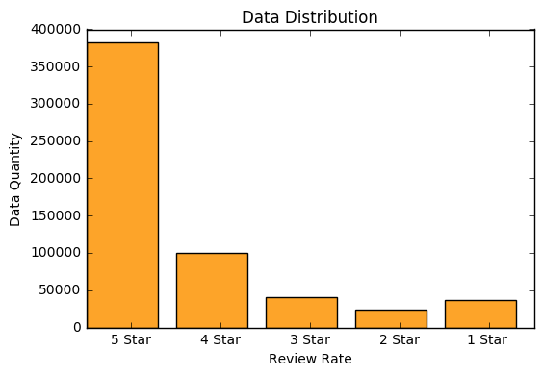
Data & Preprocessing
We used the data collected by Prof. Julian McAuley, UCSD.
Digital Music, Musical Instruments and Amazon instant Video.
Data pack contains more than a million reviews
We selected 100,000 of the entries.20,000 of each star-rating.

Slide 9

Data & Preprocessing(Cont.)
Features
reviewerID - ID of the reviewer, e.g. A2SUAM1J3GNN3B
asin - ID of the product, e.g. 0000013714
reviewerName - name of the reviewer
helpful - helpfulness rating of the review, e.g. 2/3
reviewText - text of the review
overall - rating of the product
summary - summary of the review
unixReviewTime - time of the review (unix time)
reviewTime - time of the review (raw)

Slide 10
Methodology
2

Slide 11
Methodology
The main goal of our project is to train a model to predict the overall rating of products based on user reviews.
We decide to build a LSTM for classification
Word2Vec
N-Gram
Transform the review texts to vectors as the input of RNN.
LSTM
Implement a Recurrent Neural Network (RNN) using the Long Short Term Memory (LSTM) architecture based on Tensorflow to do Text Classification
Classifier
Choose to add a layer of Softmax regression classifier after LSTM, which helps us to do Multi-class classification

Slide 12
Word2Vec
Predicts target words from source context words.
Smaller datasets.
Continuous Bag-of-Words model(CBOW)

Slide 13
Word2Vec
Predicts source context-words from the target words.
Larger datasets.
Skip-Gram model

Slide 14
Word2Vec
Skip-Gram model
A trick: not the neural network, but the hidden layer(word vectors).
Neural network: Given a specific word in the middle of a sentence (the input word), look at the words nearby and pick one at random. The network is going to tell us the probability for every word in our vocabulary of being the “nearby word” that we chose.

Slide 15

Word2Vec
Pair
Statistics of times each pairing shows up higher probability a pair shows up, more relevant the two words.
Graph from http://mccormickml.com/2016/04/19/word2vec-tutorial-the-skip-gram-model/

Slide 16
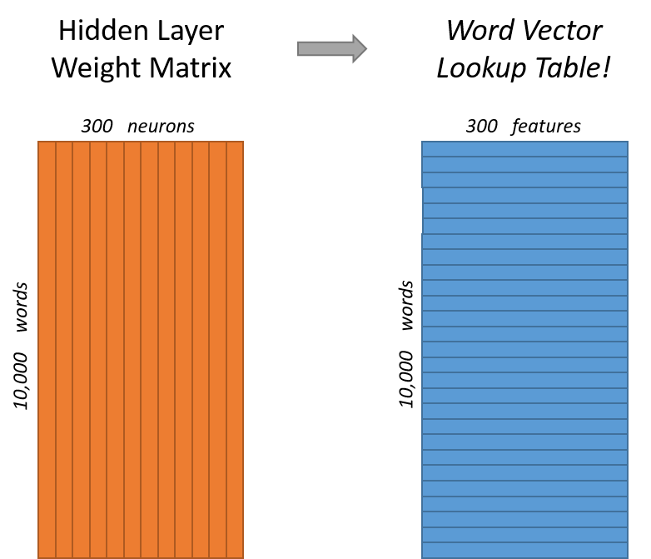
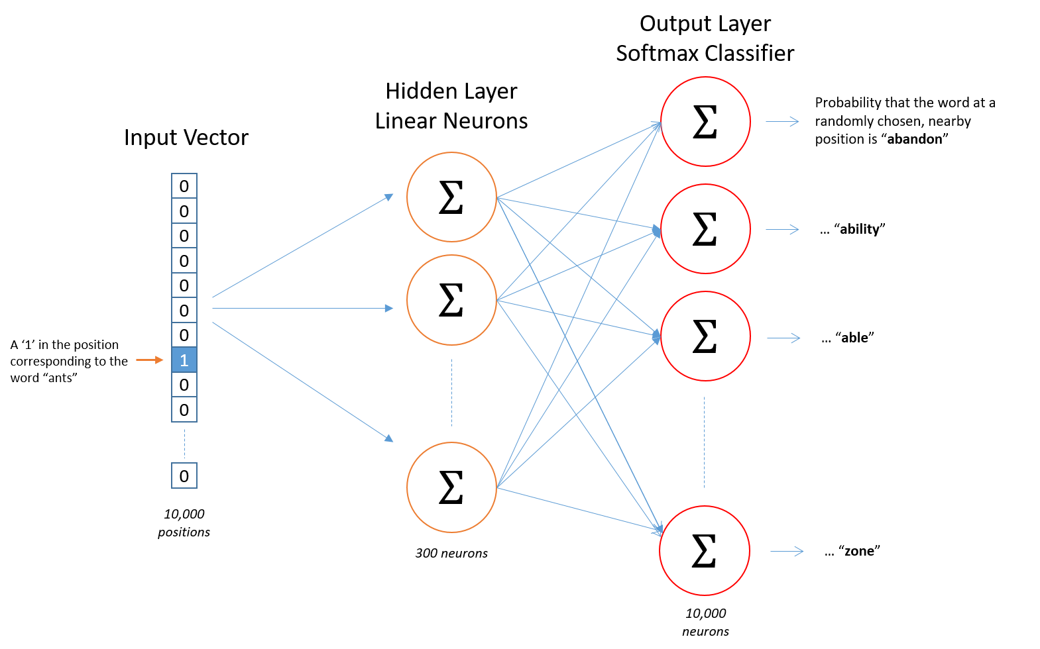
Word2Vec
Detail
Graph from http://mccormickml.com/2016/04/19/word2vec-tutorial-the-skip-gram-model/

Slide 17
Word2Vec
Gensim library: extract semantic topics from documents;
Size(dimensionality of the feature vectors): 300
Unsupervised, only need a corpus of plain text documents.
min_count: 1
vector of one word
Graph from http://mccormickml.com/2016/04/19/word2vec-tutorial-the-skip-gram-model/

Slide 18
Simple RNNs
Neural Network with two kinds of input: input from current time step(X_{t}) and previous output(h_{t-1})
Training using “Back – Propagation Through Time”(BPTT)
Work for short time-scale dependencies between input and output.
From Understanding LSTM Networks(http://colah.github.io/posts/2015-08-Understanding-LSTMs/)

Slide 19
Simple RNNs
…but what would happens across many time steps?
Hard to track the relationship between inputs and outputs.
Vanishing and Exploding Gradients.
From Understanding LSTM Networks(http://colah.github.io/posts/2015-08-Understanding-LSTMs/)

Slide 20
Long Short Term Memory networks LSTMs
Hold internal state(c_{t}) across timesteps
Gated update of state based on inputs(X_{t}), previous output(h_{t-1}) and previous state(c_{t-1}).
Graph from Recurrent Neural Network(Graves 2012)

Slide 21
LSTMs Equations
Equations from Recurrent Neural Network(Graves 2012)

Slide 22
Our Approach
1
Convert all text samples in the dataset into sequences of word indices. A "word index" would simply be an integer ID for the word. We will only consider the top 5,000 most commonly occuring words in the dataset, and we will truncate the sequences to a maximum length of 300 words.

Slide 23
Our Approach
2
3
4
Prepare an "embedding matrix" which will contain at index i the embedding vector for the word of index i in our word index.
Load this embedding matrix into a Keras Embedding layer, set to be frozen (its weights, the embedding vectors, will not be updated during training).
Build on top of it a LSTM neural network, ending in a softmax output over our 5 categories

Slide 24
Our Model
X₀
LSTM
h₀
X₁
LSTM
h₁
Embedded
Sequences
Drpp out
5
star
4
star
3
star
2
star
1
star
X₂
LSTM
h₂
…
…
X_{n}
LSTM
h_{n}
Classifier

Slide 25
Result & Analysis
2

Slide 26
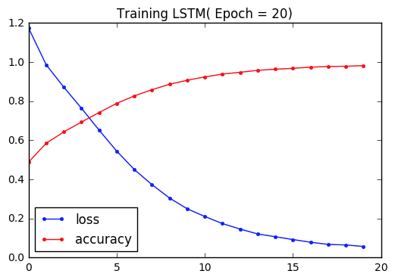
Result

Slide 27
Reference
Ups and downs: Modeling the visual evolution of fashion trends with one-class collaborative filtering R. He, J. McAuley WWW, 2016
Image-based recommendations on styles and substitutes J. McAuley, C. Targett, J. Shi, A. van den Hengel SIGIR, 2015
https://blog.keras.io/using-pre-trained-word-embeddings-in-a-keras-model.html
Sepp Hochreiter and Jurgen Schmidhuber. Long short-term memory. ¨ Neural Comput., 9(8):1735–1780, November 1997.
Tomas Mikolov, Kai Chen, Greg Corrado, and Jeffrey Dean. Efficient estimation of word representations in vector space. CoRR, abs/1301.3781, 2013.

Slide 28
Thanks!
Questions ?

